Slide 1
Report Food Logging System
________________________________________________________________
COMP5427 Usability Engineering
Tutor: Thushan Ganegedara
Group: 1

Slide 2
Summary of Key Lessons from Personal Logging
1. Minimalist and Ease of Use
Logging all the intakes can be quite tedious and frustrating.
Extra efforts need to be invested before each meal.
Taking pictures helps reducing a lot of work.
The design should be quite simple and does not take too much effort to complete the task in order to avoid such frustration.
The appearance should look clean and pleasing to the users.
Use symbols and icons that are intuitive to users to minimize complexity.

Slide 3
Summary of Key Lessons from Personal Logging
2. Timeline and Categorization
Taking pictures provides an automatic timestamp which serves well when viewing images in timeline format.
As the image’s quantity grows with the time, the problem becomes more about storage.
Lots of pictures mean difficulty in browsing or finding particular content.
Timeline is an important feature to mitigate information overload, while categorizing all the contents will convey meaningful information and is easier to retrieve.

Slide 4
Summary of Key Lessons from Personal Logging
3. Knowledge about Quantity
Snapshots of the meal do not tell us anything that is quantifiable, except meals that come in standard sizes such as a bottle of milk or a can of coke.
The difficult part when analyzing contents on an image is the size estimation.
Knowledge about recommended amount for each food group is unknown.
The design should provide users with know-how, especially serving-size estimation.
Log will be useful with quantifiable figures and can be compared against recommended quantity.

Slide 5
Summary of Key Lessons from Personal Logging
4. Visualization
The good thing about picture is that it can offer various aspects of information through a single object.
When a piece of information is to be displayed, an image can be much more effective than pure texts and numbers.
In addition, user can interpret a good designed graphical representation much faster than reading through textual information.
It also helps draw attention better.
The design should consider the use of images, graphs, and charts to indicate intake’s status and performance.

Slide 6
Summary of Key Lessons from Personal Logging
Conclusion
All four key lessons are corresponded well with the standard “Heuristics”.
“Minimalist and Ease of Use” reflects directly to the balance between “Aesthetic and Minimalist Design”.
“Timeline and Categorization” has a strong relationship to “Flexibility and Efficiency of Use”.
“Knowledge about Quantity” is exactly “Help and Documentation”.
“Visualization” provides “Recognition rather than Recall”.
The initial design should, at least, address all of these key aspects. However, applying all these does not mean the design will be usable and suited-well for the users. Other usability techniques are to be performed on the initial design. But keeping in mind the four aspects and trying to balance them can serve as an essential starting point.

Slide 7
Design Rationale and Other Influences
Throughout the process of developing the prototypes, conducting various usability evaluations has influenced many improvements on the design. All influences include:
Various aspects reflected from the initial food logging activities.
The activity serves well as a good starting point for our initial design with reflection from actual user’s experiences.
Ten aspects of Heuristics
The initial activities are corresponded a lot with majority of the Heuristics. Each prototype takes this as the main guideline for the design.
Flaws identified from the Cognitive Walkthrough's
Identified flaws provide us with quick adjustments before having the real users test the prototype.
Observation and comments received from Think-Aloud evaluations
Think-aloud is the most useful element to produce the first actual user’s contact. What users experience and how they feel are put into our improvements to try to make the design fitted well in practical use.
Feedbacks received from the questionnaires
Questionnaire is another piece of information we use to analyze against our improvements whether we have addressed all the problems and to attain the acceptable level.

Slide 8
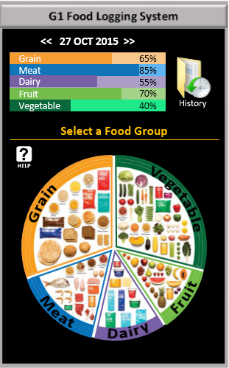
Design Rationale and Other Influences
Final Design
Minimalist Design
Clear Instruction
Assistance
Visualization
Graphs
Symbols
Images
Prime Pixels

Slide 9
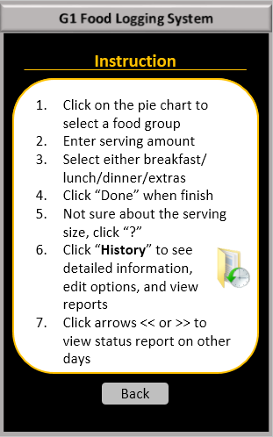
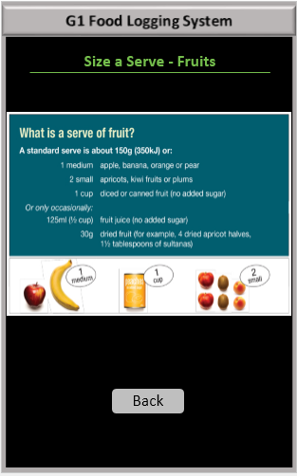
Design Rationale and Other Influences
Final Design
Consistent Format
Clear Instructions
Consistency

Slide 10
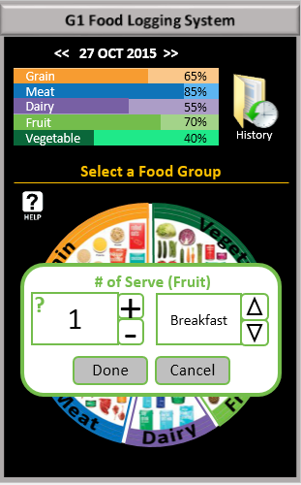
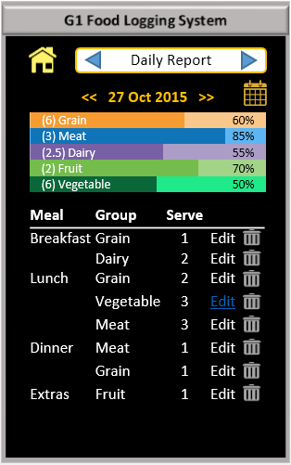
Design Rationale and Other Influences
Final Design
Intuitive
Simplicity
Help
Intuitive
Categorization

Slide 11
Think-Aloud Evaluation
Tasks: abstract and concrete, rationale
You recall that you ate 1 serve of fruit to day. Log that.
Test the simple functionality of the main and most important task of the application.
You recall that you ate 3 serves of vegetables to day. Log that.
Repeat the same aspect with similar task to confirm the design problem if it occurs in Task1.
You realise that was a mistake and you actually ate only 2 serves of vegetables. Update the logger for that.
Examine another aspect of the design which is crucial for any users when a mistake is made. In this flexibility and freedom of control are tested.

Slide 12
Think-Aloud Evaluation
Summary of relevant information about the users:
18 – 34 years old
Good mix of genders
Most are students
Medium to high computer skills
Background | P1 | P2 | P3 | P4 | P5
Age | 22 | 34 | 29 | 18 | 24
Gender | Female | Male | Female | Female | Male
Occupation | Student | Manager | Accountant | Student | Student
Computer Literacy | High | Medium | Medium | Medium | High

Slide 13
Think-Aloud Evaluation
USER 1 - Summary of Observations
 | Task 1 | Task 2 | Task 3
Success | Yes | Yes | Yes
Time | 50s | 15s | 40s
Observations | The user firstly look into Instruction, then click fruit group pie chart based on instruction. Next, the user adjust the numbers of serves into 1. Finally clicking "done". | The user click vegetable group and adjust the numbers of serves into 3. Then click "Done". | First of all, the user click on "History" and the food that the user logged is displayed on the screen. click on "Edit" button, and adjust the numbers of serves into 2. Finally click "Done".
Errors | No | No | No
User’s comments | Very easy under the instructions. | The same operation with the first task. | All information they need is displayed on the screen. The information is useful and the navigation is clearly.
The user can easily complete all three tasks in a short time. There is no errors during the user perform these tasks, because she read carefully all instructions before she preform the tasks.

Slide 14
Think-Aloud Evaluation
USER 2 - Summary of Observations
 | Task 1 | Task 2 | Task 3
Success | Yes | Yes | Yes
Time | 20s | 7s | 15s
Observations | The user looks at the pie chart and clicks on "Fruit" section. Then he changes the serve number, but couldn't find where to change the date. Then, he realizes the date up top, and proceeds by clicking "Done" | Perform the task quickly. | The user tries clicking on the graph, but nothing happens. Then, he sees the history, clicks, and finds the logged information. He searches through the log and finds vegetable item. He clicks on "edit" and changes the number.
Errors | - | - | Trying to click on the graph.
User’s comments | The date should be located close to the pie chart. It also could be better if a calendar is implemented for a faster way to select any date. | - | The history is clearly displayed, but he just didn't notice it.
The user complete all tasks very quickly. He just simply click buttons that he need. One error that made by him is that he click on the graph rather than the "History". Once he found the "History" button, he can easily finish the task.

Slide 15
Think-Aloud Evaluation
USER 3 - Summary of Observations
 | Task 1 | Task 2 | Task 3
Success | Yes | Yes | Yes
Time | 40s | 20s | 1m 15s
Observations | Looking for fruit items. User doesn’t know if bf, lunch or dinner. | Very quick. Similar procedure than task 1 | User clicked vegetable option. Then, try to find an update option. Came back to main page. User used help option.
Errors | - | -
User’s comments | Very easy and interactive | No problems | The history button is not very intuitive in order to update an item.
All tasks can be successfully performed by the user. For the first two task, the users can finish them very easily without any problems. When the user preform the third task, he click on "Help" to help him complete the task.

Slide 16
Think-Aloud Evaluation
USER 4 - Summary of Observations
 | Task 1 | Task 2 | Task 3
Success | Yes | Yes | Yes
Time | 16s | 9s | 36s
Observations | The user did the logging through the pie chart after some error operation. | The user quickly did the logging through the pie chart | The user was not sure about where to click, so she clicked the help button, and read closely until she found instructions on task 3. And then successfully completed the task.
Errors | The user tried to click at the spreadsheet at first. | No | No
User’s comments | It could better if the instruction is "select a food group to log" | Pretty easy, because it is basically the same with Task 1. | The help information is useful.
The user can complete all tasks in the case of relying on the help information and has some suggestions for the help.

Slide 17
Think-Aloud Evaluation
USER 5 - Summary of Observations
 | Task 1 | Task 2 | Task 3
Success | Yes | Yes | Yes
Time | 30s | 15s | 30s
Observations | The user skipped the Instruction at the first time and then go back through help. After spending a few seconds to read it, the task is done quickly. | Easy and quick. | The user go back and check the instruction again and then finished the task without problem.
Errors | N/A | N/A | N/A
User’s comments | Instruction is too long to be read totally. | Easy | instruction looks not perfect.
The user can finish all tasks properly and the only problem with him is that the instruction seems not so friendly and might make the experience slightly worse.

Slide 18
Think-Aloud Evaluation
Summary of Key Problems Identified
The history button is not so intuitive for updating records.
The interface of instruction is not perfectly user-friendly
“Size a serve” button is not easy to figure out in the number of serves field. Its size and location is not so intuitive for user experience.
There is no changes or process status when user enter a new record.

Slide 19
Think-Aloud Evaluation
Critique of the Work
The demographics of participants for think-aloud tasks do not has good coverage. The age range only covers 18 to 34. In addition, none of the participants has low computer literacy.
Further TA tests for a wide number of users and with different background (range of age or computer literacy), would allow us to can get other problems and comments about the user experience and their usability.

Slide 20
Think-Aloud Evaluation
Critique of the Interface
The entry data for new records is not straightaway in the main. It must be done after choose a food group.
The dashboard, where the dairy intake are, is smaller than food group buttons. Better implementation could allow to see bigger dairy intakes better spread out in the main screen.
Indication of recommended serves could be display clearly. This mean, use different colour when the ideal intake is reached for the user.
The current system just allow registering food for 5 groups. In order to make the system more scalable and adaptable should permit register of any food and drinks.
Show more notes in order to head the user through the system. Also, show changes status when a new record or action has been done in the system.

Slide 21
Cognitive Walkthrough
Task 1 - You recall that you ate 1 serve of fruit today. Log that.
Prototype | Problems | Actions Taken
Ver.1 | The heading “Log by Food Group” causes confusion. Instruction is not obvious to users, unless they consult “Help”. User cannot clearly see the system response after finish logging. | Rephrase the term to “Select a Food Group” so that it serves as both a heading and an instruction. Implement percentages on the bar chart, so users can see the change when finish logging an item. (i.e. change in percentage)
Ver.2 | The pie chart with sections of food group contain some images which are too small to recognize. “Help” is supposed to direct users to a detailed instruction, but the appearance does not stand out. | Insert name for each group in text format, in addition to the images. Change “Help” to icon with more obvious color (i.e.white).

Slide 22
Cognitive Walkthrough
Task 2 - You realise that was a mistake and you actually ate only 2 serves of vegetables. Update the logger for that.
Prototype | Problems | Actions Taken
Ver.1 | The heading “Daily Summary” does not refer to the logged information which can be edited, updated, and deleted. Bar chart on “Detailed Information” page does not inform users the recommended amount of serve. It only indicates percentages of consumed vs. recommended. | Rephrase the term to “Detailed Information” so that appropriate action is more obvious to users. Insert the recommended serves of each group on the bar chart. (this is based on the user’s profile)
Ver.2 | The heading “Detailed Information” still in not clear enough for users to refer to recorded items. | Change it to “History” with an icon. This helps user to recognize and refer to all items they have logged.

Slide 23
Cognitive Walkthrough
Critique of the Work
Trying to think as if we are the users can be difficult due to the differences of mental models and system images.
Words selection may not be obvious enough for the users to perform correct actions.
Attempting to provide enough instructions may result in a less minimalist appearance.
There is no obvious status to inform the users when a log is successfully entered, except for the change in bar chart and the percentages.

Slide 24
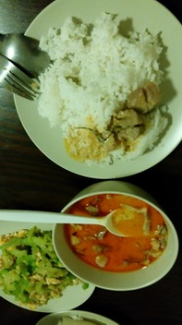
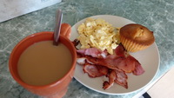
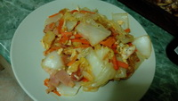
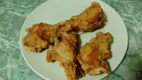
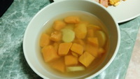
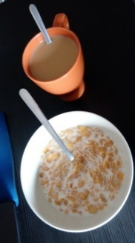
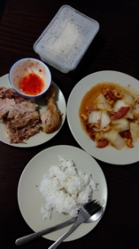
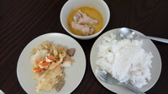
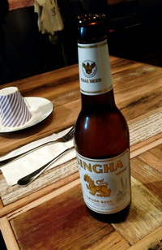
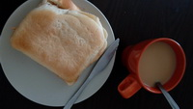
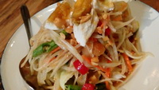
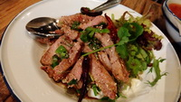
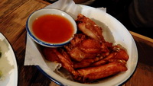
Appendix 1 – Initial Logging Activity
Tossapol Sakawkanokrat
Weekday (Day 1)
Weekday (Day 2)
Weekend (Day 1)

Slide 25
Appendix 1 – Initial Logging Activity
Tossapol Sakawkanokrat
Reflective Summary
Logging food intakes by taking photos of the meal is one efficient method to keep track of all the daily consumption. Using camera to capture the meal is fast and timeline-based while can provide details of the meal. When I browse through all my photos, I know exactly what I have eaten in chronicle order.
However, this method does not provide useful figures, especially regarding the amount. Also, logging by images can become very messy over time when there are too many photos to browse through.
Besides the timeline, organizing the photos using folders structure can be more efficient over time. In terms of the amount, this method may not be a good solution if I want to visualize or compare my consumption over time.

Slide 26
Appendix 1 – Initial Logging Activity
Sebastian Rubio
Weekday (Day 1)
Weekday (Day 2)
Weekend (Day 1)

Slide 27
Appendix 1 – Initial Logging Activity
Sebastian Rubio
Reflective Summary
This experiment was on time with my national party. The days recorded for this experiment were a little difference above all the Saturday were I ate and drank more than habitual. However, I felt really good for being aware of how much food and drink intake in order to know and may be reduce my bad behaviors like drinking too much coffee or eating thinks do not nutritive for me.
The method used for recording this experience was a little tedious. Sometimes were very difficult to take a picture of my food or drink because I am not use to do this. But this method is useful to realize how much we eat and drink with a very cheap and easy process.
I think the accuracy of this method is almost 100%. The fact of having the picture of my food made me realize the dairy intake (visualization) of main food and drink and considering drinking more water instead of coffee or another drinks. I felt like a nutritionist but instead of going to an appointment, I did my own nutritional evaluation with this log based on photographing method.

Slide 28
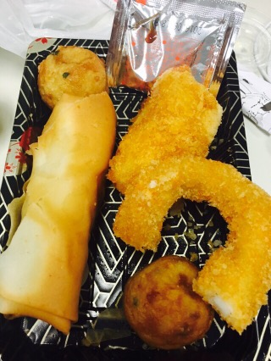
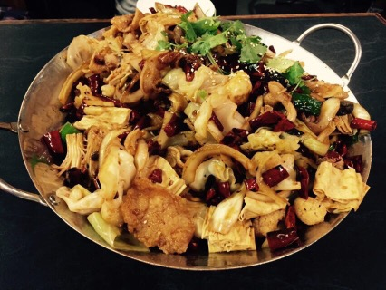
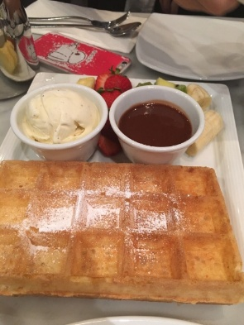
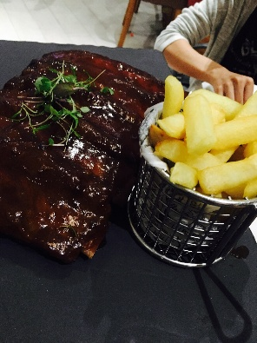
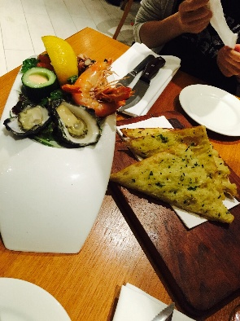
Appendix 1 – Initial Logging Activity
Jiaqi Sun
Weekday (Day 1)
Weekday (Day 2)
Weekend (Day 1)

Slide 29
Appendix 1 – Initial Logging Activity
Jiaqi Sun
Reflective Summary
In order to summarize the intake of the main food that I ate, firstly I took photo of everything that I ate for these days and make notes for each group. All food that I ate can be divided into 5 groups, which includes grain, meat, dairy, fruit and vegetable.
Based on website, I have to calculate how many serves that I eat for each group and make a table to record all food that I ate. The process of recording and creating tables is wasting a lot of time, because any apps can help us to do that. All we need is to type in or click on what we ate in the apps. However, in this case, we have to make a note for everything we ate and summaries daily records by ourselves. Therefore, we can use some apps to solve this problems.

Slide 30
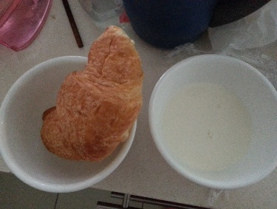
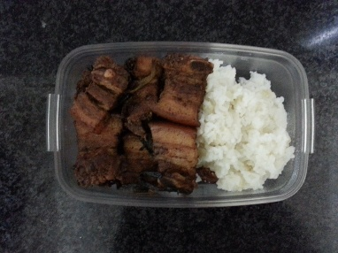
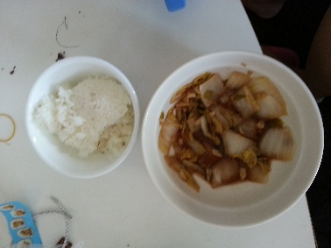
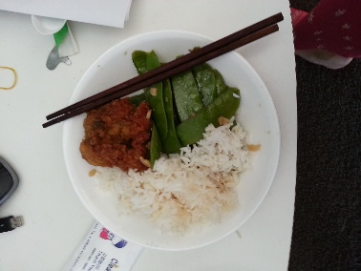
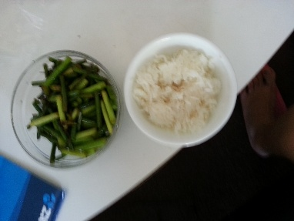
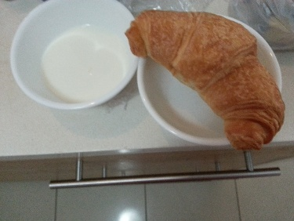
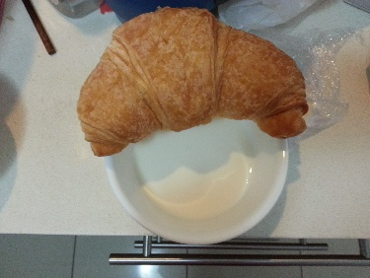
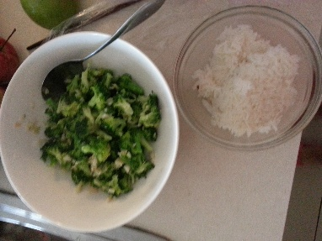
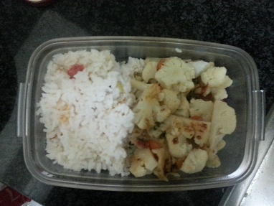
Appendix 1 – Initial Logging Activity
Yue Zhang
Weekday (Day 1)
Weekday (Day 2)
Weekend (Day 1)

Slide 31
Appendix 1 – Initial Logging Activity
Yue Zhang
Reflective Summary
Logging daily food by photograph is not very convenient for me. It is because I always forget to take photos on my meal before I started eating.
Besides, owing to the fact that the meal time is not always fixed, so I cannot set an alarm to remind myself. The second problem is the picture itself cannot provide any information except from what I ate. For example, the amount of food cannot be effectively presented by pictures.
Another problem is that keep taking photos will result in the shortage of storage in my phone.

Slide 32
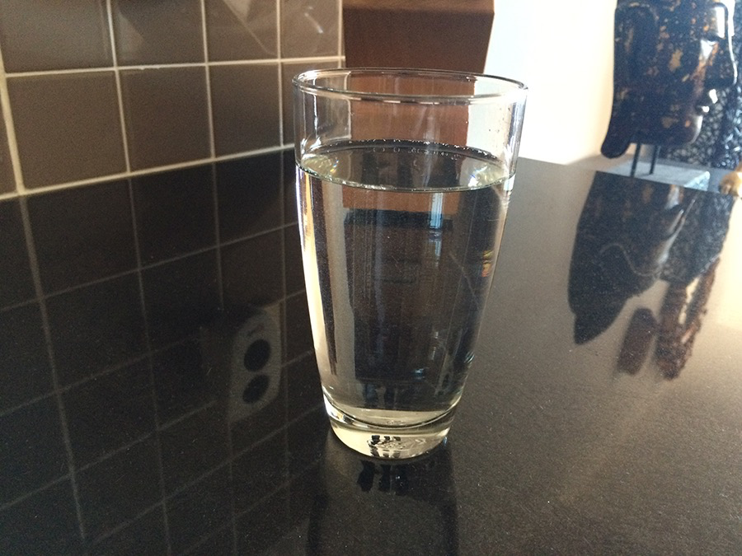
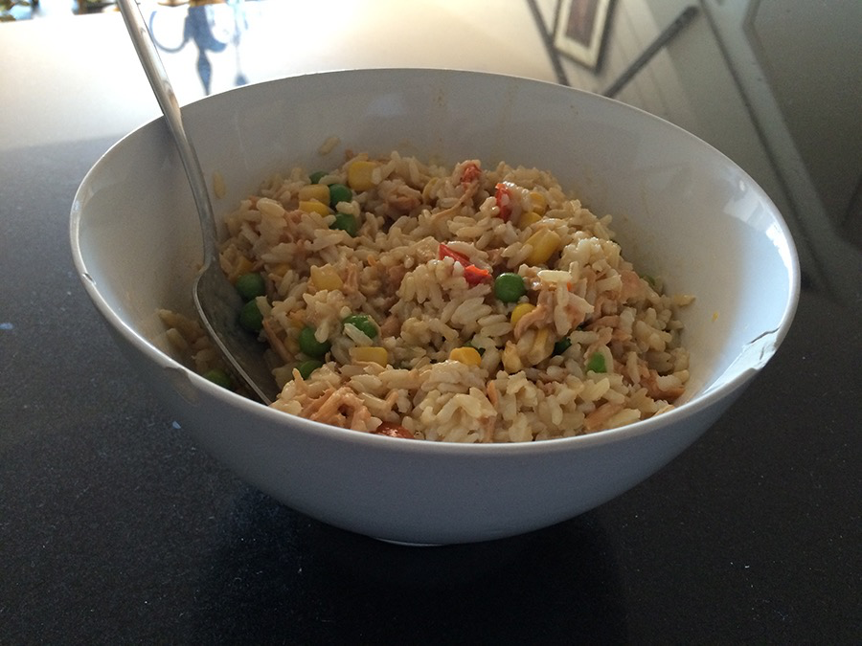
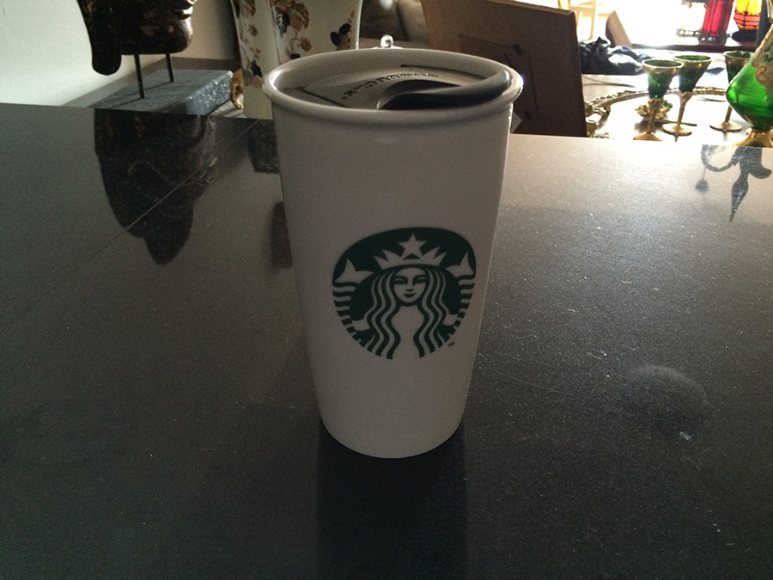
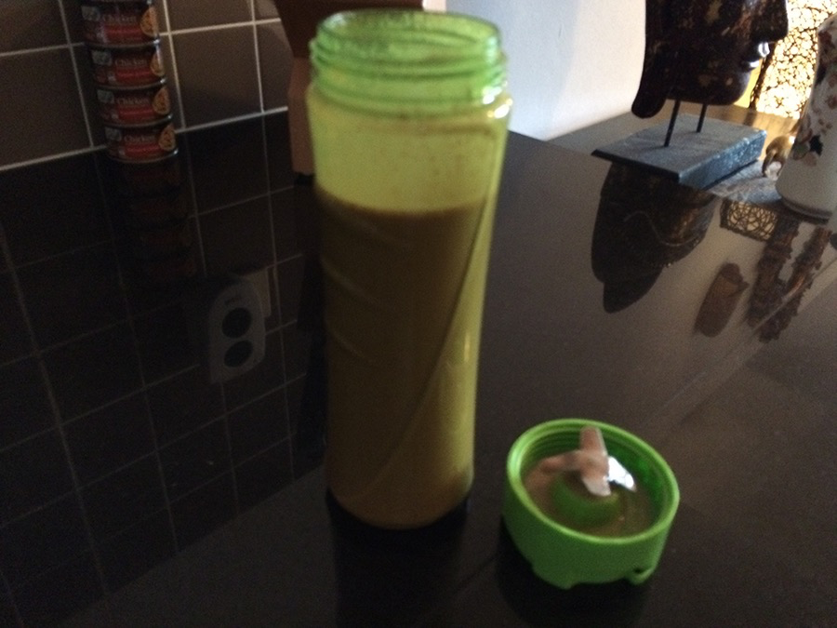
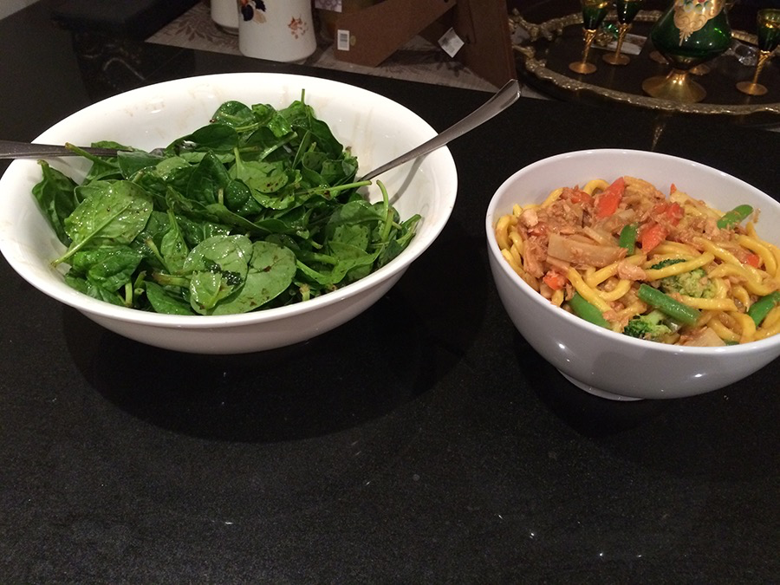
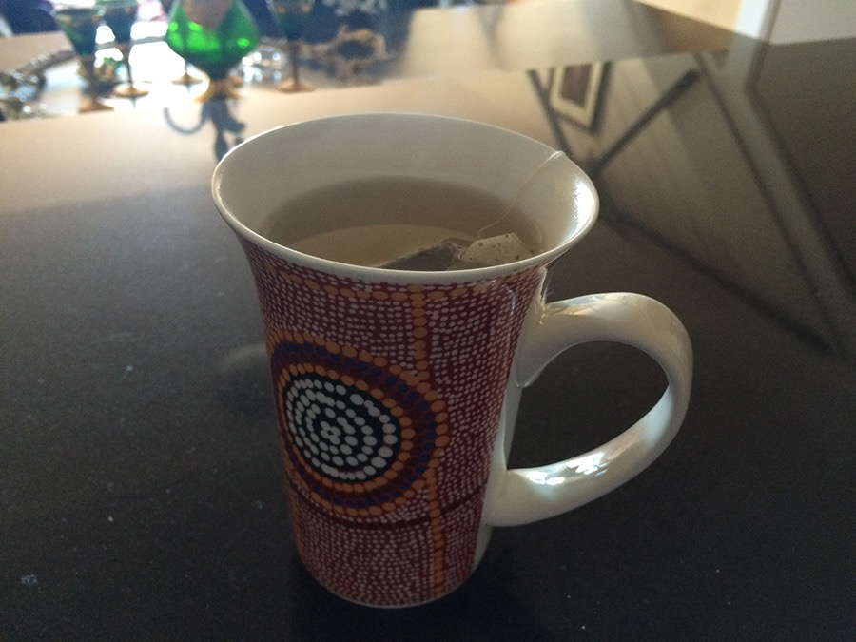
Appendix 1 – Initial Logging Activity
Camilo Hoffmann Kuschel
Weekday (Day 1) & Weekday (Day 2) Weekend (Day 1)

Slide 33
Appendix 1 – Initial Logging Activity
Camilo Hoffmann Kuschel
Reflective Summary
Despite the fact that I had never done a complete food and liquid ingestion log like this one that we had for homework, it did not show me anything new. Two reasons contributed for this exercise not to bring up anything that I either already knew or were familiar with.
First, since I am diagnosed with Irritable Bowel Syndrome (IBS), I follow a quite strict diet and eat and drink pretty much the same things every day.
Second, since I have a Fitbit band, I already log the liquid I ingest on a daily basis on the Fitbit app on my phone. And as it can be seen in the picture, I ingested 1700ml, 1400ml and 2,150ml of water on Wednesday 16/09/2015, Thursday 17/09/2015 and Saturday 20.09.2015 respectively; which were the days I chose to do this homework exercise.
However, although it did not bring up anything new to me, I acknowledge the importance of such in terms of starting an understanding of how logging activities can be both extremely boring and time consuming; which I am quite sure was basically the point of all this—to start in us a feeling that we can think it through and suggest easier and more enjoyable ways of doing it.

Slide 34
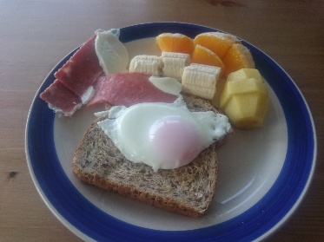
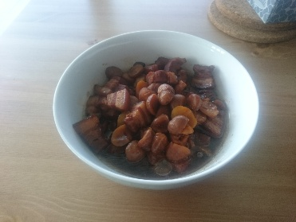
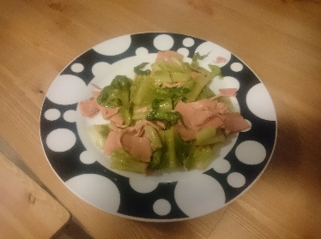
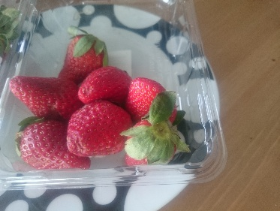
Appendix 1 – Initial Logging Activity
Yunxiang Lin
Weekday (Day 1)
Weekday (Day 2)
Weekend (Day 1)
Forgot to take photos

Slide 35
Appendix 1 – Initial Logging Activity
Yunxiang Lin
Reflective Summary
Logging daily food by photograph is not finished well by me. It is always happened that I could only realize to take photos on my meal just when I finished eating.
In addition, my timetable has many variations in the weekdays so that setting an alarm is not a good reminding way. It is difficult to accurately express the actual intake by the pictures taken as it is not all eaten.

Slide 36
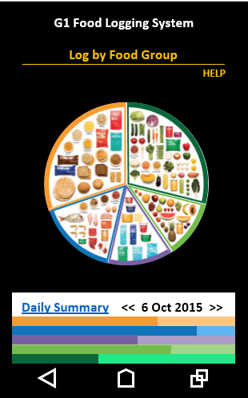
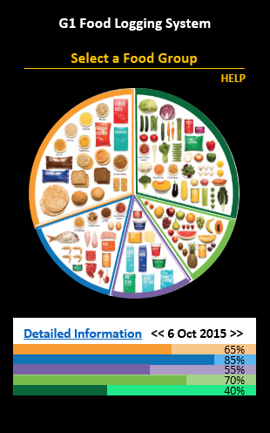
Appendix 2 – History of Prototypes
Prototype 1
Cognitive Walkthrough
“Log by Food Group” does not serve well as an instruction to click on the pie chart.
Change the heading to a self-explained message “Select a Food Group”

Slide 37
Appendix 2 – History of Prototypes
Prototype 1
Cognitive Walkthrough
“Daily Summary” does not refer to detailed information, which can be edited.
Change the message to “Detailed Information”

Slide 38
Appendix 2 – History of Prototypes
Prototype 1
Cognitive Walkthrough
Neither percentages nor recommended amounts is indicated.
Insert numbers on the bar graph

Slide 39
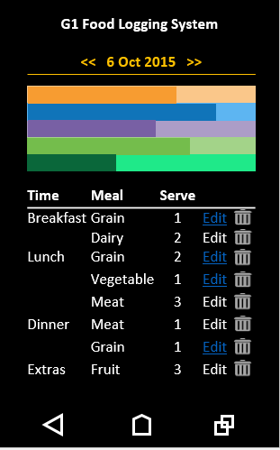
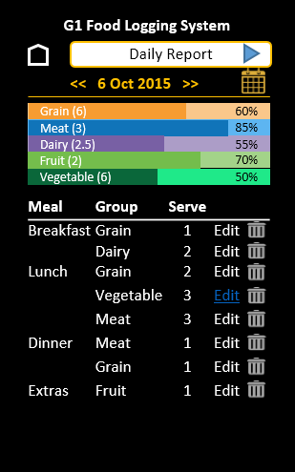
Appendix 2 – History of Prototypes
Prototype 1
Think-Aloud
User finds that it is hard to navigate to a specific date in the past.
Add a calendar so that users can navigate to an exact date with ease.

Slide 40
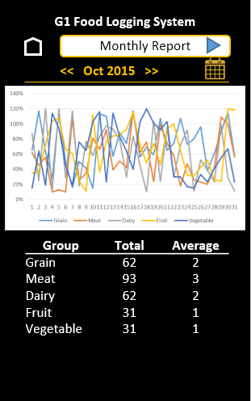
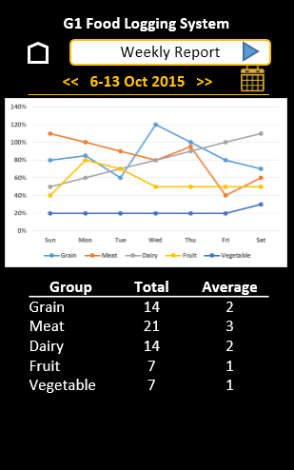
Appendix 2 – History of Prototypes
Prototype 1
Think-Aloud
User would like to see the summary of intakes over time, i.e. weekly or monthly.
Add weekly and monthly summary features.

Slide 41
Appendix 2 – History of Prototypes
Prototype 2
Cognitive Walkthrough
The pie chart with sections of food group may contain some images which are too small to recognize.
Insert name for each group in text format, in addition to the images.

Slide 42
Appendix 2 – History of Prototypes
Prototype 2
Cognitive Walkthrough
“Help” is supposed to direct users to a detailed instruction, but the appearance does not stand out.
Change “Help” to icon with more obvious color (i.e.white).

Slide 43
Appendix 2 – History of Prototypes
Prototype 2
Cognitive Walkthrough
“Detailed Information” may not be obvious to the users for making updates.
Change to “History” with an icon. This should help user to recognize and refer to all items they have logged.

Slide 44
Appendix 2 – History of Prototypes
Prototype 2
Think-Aloud
Users do not understand what the bar graph is and what it is for.
Add text information and numbers to convey the meanings

Slide 45
Appendix 2 – History of Prototypes
Prototype 2
Think-Aloud
The date, which is located at the bottom, is not obvious to the users when trying to log for a specific date.
Separate the date from status graph and move the whole section to the top, so that it makes the first contact with users.

